Slide 1

SYNOPSIS Presentation
on
<< FOODIE – Online Food Ordering and Restaurant Website >>
by
<<Arun Kumar>> <<2628mca0295@kiet.edu>>
<<Anshu Kumar>> <<2628mca0316@kiet.edu>>
<<Anjali Tyagi>> <<2628mca0258@kiet.edu>>
Session: 2026 - 2027 (I Semester)
Under the Supervision of
Mrs. Mahima Tayal (Assistant Professor)
Department of Computer Applications
KIET Deemed To Be University , Delhi - NCR , Ghaziabad-201206

Slide 2
FOODIE – Online Food Ordering
and Restaurant Website
Arun Kumar - 2628mca0295
Anshu Kumar - 2628mca0316
Anjali Tyagi - 2628mca0258
Date - September 14 , 2026

Slide 3
Project Overview
  Foodie is a responsive frontend web application designed to provide a simple and convenient food-ordering experience.
  It allows users to explore the restaurant's food menu, select food categories, and access an order-tracking interface.
  The homepage specifically promotes easy ordering directly from the table, allowing customers to scan, choose their food, and place an order without waiting
Main Features:
  Attractive home page
  Easy food ordering interface
  Explore Menu option
  Food category filtering
  Biryani category
  Chinese category
  Desserts category
  Drinks category
  Order tracking
  Order ID input
  Table Number input
  Responsive user interface

Slide 4
Objectives
The main objectives of the Foodie project are:
  To develop a modern and attractive food-ordering website.
  To create a simple and user-friendly interface.
  To allow customers to explore available food items.
  To provide an Order Tracking interface.
  To allow users to enter their Order ID and Table Number.
  To provide clear call-to-action buttons.
  To demonstrate practical implementation of HTML, CSS, and JavaScript.
  To improve the overall digital food-ordering experience.
Measurement of Success
  The project can be considered successful if:
  Users can easily navigate the website.
  Users can access the menu without confusion.
  Food categories are clearly displayed.
  Users can access the order-tracking page.
  Users can enter Order ID and Table Number.
  The interface works properly on different screen sizes.

Slide 5
Scope
The scope of the project is focused on the frontend development of the Foodie restaurant website.
Included in the Project:
Home Page
  Foodie branding
  “Good Food. Good Mood.” heading
  Food-related introduction
  Explore Menu button
  Track Order button
Order Tracking Page
Menu Page
Responsive UI (Excluded)
  Pizza
  Burger
  Biryani
  Chinese
  Desserts
  Drinks
  Order ID
  Table Number
  Production backend
  Permanent database
  Online payment gateway
  Real-time delivery GPS

Slide 6
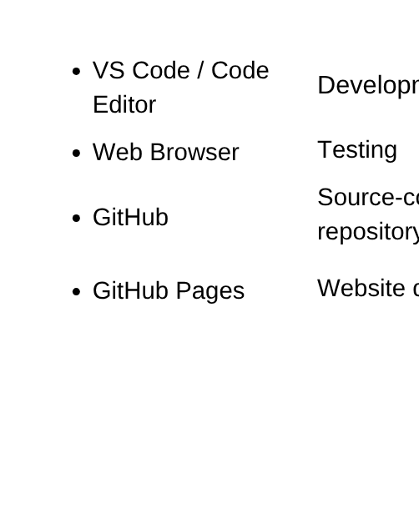
Methodology
Development Methodology
The website can be developed in the following stages:
Step 1 – Requirement Analysis
Identify the main requirements:
  Food menu
  Food categories
  Ordering interface
  Order tracking
  Responsive design
Step 2 – UI Design
Design the layout of:
  Home page
  Menu page
  Food cards
  Buttons
  Tracking page
  Footer
Step 3 – Frontend Development
Develop the interface using:
  HTML5 → CSS3 → JavaScript
Step 5 – Deployment
Step 4 – Testing
Test:
  Navigation
  Buttons
  Menu categories
  Responsive layout
  Order tracking interface
  Input fields

Slide 7
Hardware and Software Requirement
Hardware Requirements
Software Requirements
  Windows / Linux / macOS
  Visual Studio Code or any HTML editor
  Google Chrome / Microsoft Edge / Firefox
  Git
  GitHub account
  GitHub Pages
Minimum Hardware:
  Computer/Laptop
  Processor: Dual Core or above
  RAM: 4 GB minimum
  Storage: At least 500 MB free space
  Keyboard and Mouse
  Internet connection for online deployment/testing
For Users:
The website can be accessed using:
  Desktop
  Laptop
  Tablet
  Smartphone
Technologies
Frontend:
HTML5
CSS3
JavaScript
Database:
Not included in the current frontend project
Backend:
Not included in the current frontend project
Hosting:
GitHub Pages

Slide 8
Timeline
A suitable development timeline for the Foodie frontend project is:
Phase | Work | Timeline
Phase 1 | Requirement Analysis | Week 1
Phase 2 | Website / UI Planning | Week 1
Phase 3 | Home Page Development | Week 2
Phase 4 | Menu & Food Categories | Week 2
Phase 5 | Order Tracking Interface | Week 3
Phase 6 | JavaScript Interactions | Week 3

Slide 9
Phase 7 | Responsive Design | Week 4
Phase 8 | Testing & Bug Fixing | Week 4
Phase 9 | GitHub Deployment | Week 5
Phase 10 | Final Documentation & Presentation | Week 5

Slide 10
Simple Gantt Representation
Week 2
Week 3
Week 4
Week 1
Week 5
Requirement Analysis
UI Planning
Home Page
Menu Development
Order Tracking
JavaScript
Responsive Design
Testing
Deployment
Documentation

Slide 11
Outcomes
  Web Application Development – Foodie Online Food Ordering & Order Tracking Website
  Responsive Frontend Development using HTML5, CSS3, and JavaScript.
  Online Food Ordering Interface: Users can explore food categories, view food items, and interact with ordering features.
  Order Tracking Interface: Users can track their order using Order ID and Table Number.
  Responsive UI/UX: Website designed for desktop, tablet, and mobile devices.
  Deployment: Website successfully deployed online using GitHub Pages.
  Future Scope: Integration of backend, database, payment gateway, authentication, and real-time order management to convert it into a complete full-stack application.
  Research Paper Publication: A research paper can be prepared and submitted based on the development of the Foodie Online Food Ordering Website, focusing on its responsive UI/UX design, food menu management interface, ordering process, and order-tracking functionality using HTML5, CSS3, and JavaScript.
  Patent Filing/Grant: The project may be considered for patent filing if an innovative and novel technical approach is developed, particularly around its food-ordering or order-tracking solution. A patent grant would be subject to novelty, inventive-step, and eligibility requirements.

Slide 12
THANK YOU !

